Slide 1
Earth’s Energy

Slide 2
Where does the energy on Earth come from and how is it distributed around the planet?
Learning objectives
The sun is the primary source of energy on Earth
Warming the lower atmosphere
Greenhouse gases are essential
Movement of energy throughout Earth’s systems
To answer this question, we will:
Identify sources of energy and understand how energy is absorbed, reflected, and backscattered by different surfaces
Discuss the greenhouse effect and the effect of greenhouse gases on global temperature
Explore ways that energy is circulated throughout the Earth

Slide 3
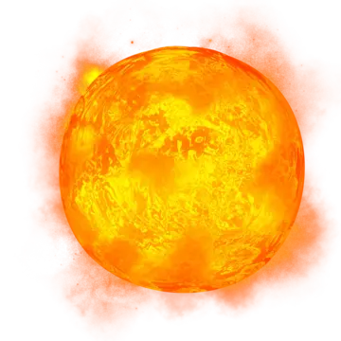
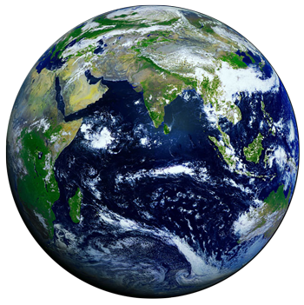
Earth’s energy comes from the sun
Learning objectives
The sun is the primary source of energy on Earth
Warming the lower atmosphere
Greenhouse gases are essential
Movement of energy throughout Earth’s systems
The sun radiates heat and light, AKA solar energy
Incoming solar radiation, or insolation
Essential for life on Earth
Earth revolves around the sun
Results in variations in insolation throughout the year
Notes:
Earth’s main source of energy is the sun, the closest start to earth.
We can call this solar energy, solar radiation, or insolation.
The sun is essential for life to exist on earth. The earth would be unlivable for us if we didn’t have energy entering our atmosphere from the sun.
Likewise, we could not grow plants and we wouldn’t have atmospheric or oceanic currents, winds, or clouds!
The earth revolves around the sun, which results in the amount of insolation various points on earth receive to change throughout the year – this is how we get seasons.

Slide 4


The lower atmosphere is warmed by energy from the Earth
Learning objectives
The sun is the primary source of energy on Earth
Warming the lower atmosphere
Greenhouse gases are essential
Movement of energy throughout Earth’s systems
Shortwave
radiation
Longwave
radiation
Notes:
*NOTE: This slide is animated! Use clicks to move through the process.*
The lower atmosphere (if you have discussed layers of the atmosphere, this can be referred to as the troposphere) – where we live! – is warmed by energy that is radiated by the earth.
Let me explain!
The lower atmosphere where we live cannot absorb solar radiation/insolation.
A good example here: Our bodies can absorb insolation! So, on a cold day, you can stand in the sun and feel warm from absorbing insolation but the air around you is cold as it is not absorbing insolation!
Insolation enters our atmosphere with a high amount of energy (shortwave radiation)
The Earth’s surface absorbs insolation and warms through conduction.
The earth reradiates this energy as a lower energy radiation (longwave radiation).
The atmosphere CAN absorb longwave radiation and uses this energy to warm.

Slide 5
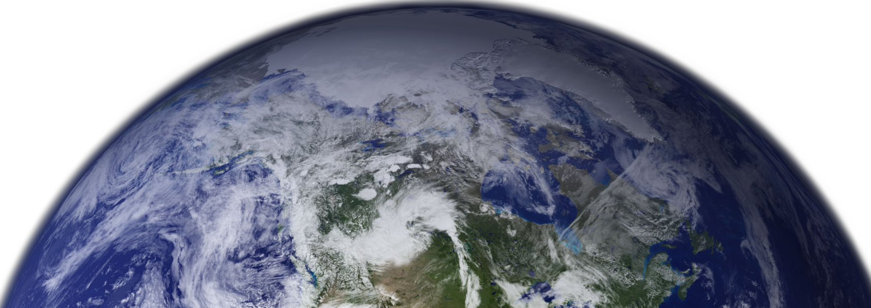
Greenhouse gases are essential to warming process!
Both natural and human-produced greenhouse gases absorb longwave radiation radiated by the Earth and hold heat close to the Earth’s surface
Without greenhouse gases, energy would be released into space and the Earth would be uninhabitable!
Learning objectives
The sun is the primary source of energy on Earth
Warming the lower atmosphere
Greenhouse gases are essential
Movement of energy throughout Earth’s systems
O₃
CO₂
CH₄
CO₂
N₂0
CO₂
H₂0
CO₂
HFC
N₂0
CO₂
H₂0
N₂0
CH₄
CO₂
O₃
CO₂
CO₂
HFC
H₂0
H₂0
O₃
CO₂
HFC
CO₂
CO₂ – carbon dioxide
CH₄ – methane
N₂O – nitrous oxide
H₂0 – water vapor
O₃ - ozone
HFC - hydrofluorocarbons
CH₄
H₂0
Notes:
*NOTE: this slide is animated. Use clicks to move through the various gases.*
Greenhouse gases are essential to warming the lower atmosphere.
These gases are capable of absorbing the longwave radiation that is radiated by the earth.
They can hold this heat and/or radiate it. GHG’s essentially act as a blanket for the earth.
The main greenhouse gases are carbon dioxide (most abundant), methane, nitrous oxide, water vapor, and manmade chemicals such as hydrofluorocarbons.

Slide 6



Planetary energy balance
Backscattered
Learning objectives
The sun is the primary source of energy on Earth
Warming the lower atmosphere
Greenhouse gases are essential
Movement of energy throughout Earth’s systems
Reflected by clouds
Emission by clouds
Absorbed by clouds
Emission by Greenhouse gases (GHGs)
Absorption by clouds
Absorbed by aerosols
HFC
CO₂
CH₄
O₃
N₂0
Absorption by GHG’s
Reflected
by surface
Emission by the surface
Absorbed
Notes:
*NOTE: this slide is animated. Use clicks to move through the reflections and absorptions.*
Much of the insolation the earth receives is absorbed* by the earth. However, this is not the only way in which energy moves throughout the system.
On its way through the atmosphere, some of this insolation is absorbed* by clouds and aerosols (e.g., dust, sea salt).
This same insolation can be reflected* by the various surface features, such as water, vegetation, concrete, and cars. But it can also be reflected back to space* by clouds and through the process of light scattering (like a rainbow or sunset).
On the other hand, we have the longwave radiation emitted by the earth. Some of this is emitted directly back to space*, whereas some of it is absorbed by clouds and greenhouse gases*.
After clouds and greenhouse gases absorb longwave radiation, they can emit* this same radiation back to space or back towards the Earth’s surface.

Slide 7
Movement of energy by the atmosphere
Learning objectives
The sun is the primary source of energy on Earth
Warming the lower atmosphere
Greenhouse gases are essential
Movement of energy throughout Earth’s systems
Heat and energy are moved throughout the earth via the atmosphere and ocean
Distribution of thermal energy between the tropics towards the poles
Notes:
*NOTE: arrows are animated*
The energy in our system is transported throughout the earth via the ocean and atmospheric movement.
In this image, we can see the general prevailing wind belts in the atmosphere. This provides movement of the air from one location to another. In areas of the Earth that are more heated than others, such as the equator, heat is moved and distributed more poleward.

Slide 8

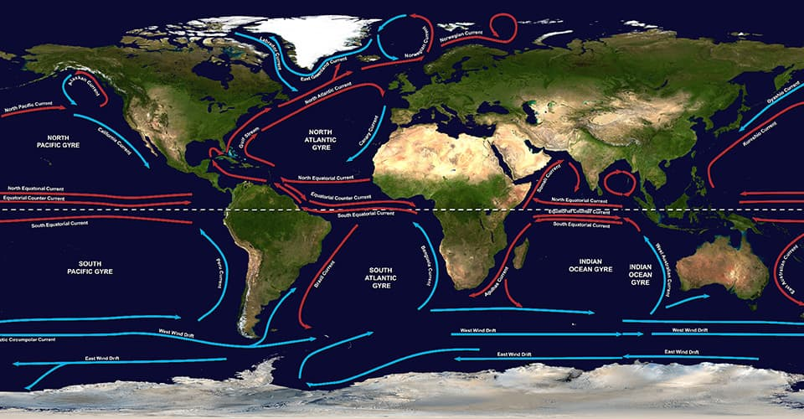
Movement of energy by the ocean
Learning objectives
The sun is the primary source of energy on Earth
Warming the lower atmosphere
Greenhouse gases are essential
Movement of energy throughout Earth’s systems
Image copyright National Oceanic and Atmospheric Administration (NOAA). https://oceanservice.noaa.gov/facts/gyre.jpg
Notes:
*Note: slide is animated to highlight just the north Atlantic area on first click*
The ocean similarly works to move thermal energy from the tropics towards the poles.
This area in the north Atlantic is particularly important. You can see that we have warm water moving north from the equator, along the eastern US as the Gulf Stream and then up towards Europe. This is what keeps Europe’s climate fairly mild as compared to similar latitudes, such as in Canada.

Slide 9
Where does the energy on Earth come from and how is it distributed around the planet?
Learning objectives
The sun is the primary source of energy on Earth
Warming the lower atmosphere
Greenhouse gases are essential
Movement of energy throughout Earth’s systems
The energy that heats the atmosphere and oceans comes from the sun
Greenhouse gases are essential for warming the atmosphere
Incoming solar radiation is absorbed by clouds and the Earth’s surface and reflected by clouds and water
Radiation emitted by the Earth is absorbed by clouds and greenhouse gases and warms the lower atmosphere
Energy is moved throughout the Earth via atmospheric winds and movement of the ocean

Slide 10
Discussion Prompts
List sources of energy emission, absorption, reflection, and backscatter. Note that some surfaces (e.g., clouds) are sources of more than one of these.
Based on what you learned, how would an increase in greenhouse gas concentrations affect temperature?
Suppose the ocean and air stopped circulating. Would the difference in temperature between the equator and poles increase, decrease, or stay the same? In a few sentences, explain your response.

